Slide 1


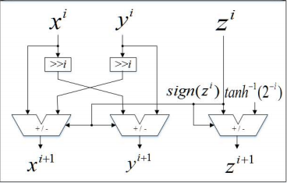
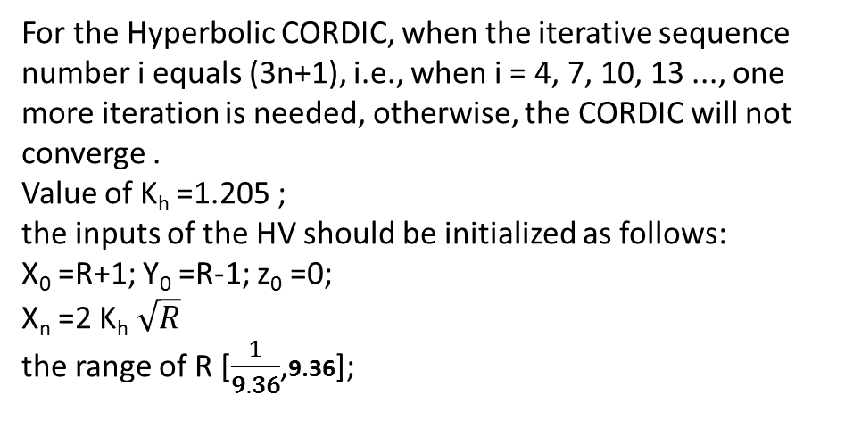
Mini Project Title: Hardware implementation of square Root based on Pipelined Coordinate Rotation Digital Computer (CORDIC) Hyperbolic vectoring mode
The iterative formulas of HV:
For the Hyperbolic CORDIC, when the iterative sequence number i equals (3n+1), i.e., when i = 4, 7, 10, 13 ..., one more iteration is needed, otherwise, the CORDIC will not converge .
Value of K_{h} =1.205 ;
the inputs of the HV should be initialized as follows:
X₀ =R+1; Y₀ =R-1; z₀ =0;
X_{n} =2 K_{h} $\sqrt{R}$
the range of R [$\frac{1}{9.36}$,9.36];
Input (R) bit size:20

Slide 2
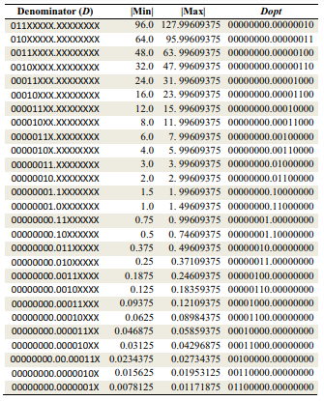
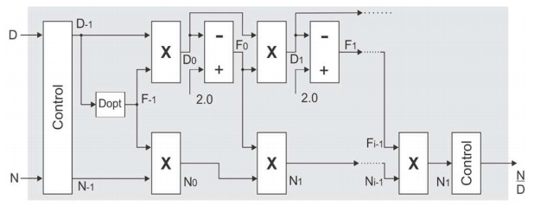


Mini Project Title: Hardware implementation of Goldschmidt Fixed-Point Divider
Input N,D is in 8.8 fixed point format
Store output values in s ram of size 20*16
Look up table
Reference:Improved Goldschmidt Algorithm for Fast and Energy-Efficient Fixed-Point Divider Guilherme Paim1 , Pedro Marques2 , Eduardo Costa2 , Sergio Almeida2 , Sergio Bampi¹ 1 Graduate Program in Microelectronics (PGMicro) - Federal University of Rio Grande do Sul (UFRGS), Porto Alegre, Brazil 2 Graduate Program on Electronic Engineering and Computing, Catholic University of Pelotas (UCPel), Pelotas, Brazil {gppaim, bampi}@inf.ufrgs.br,{pedro, eduardo.costa, sergio.almeida}@ucpel.edu.br

